Slide 1
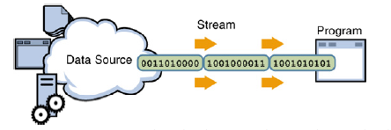
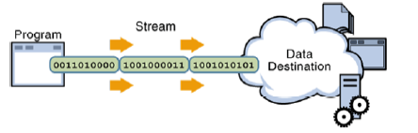
I/O Streams
A program uses an input stream to read data from a source, one item at a time.
A program uses an output stream to write data to a source, one item at a time.

Slide 2
I/O Streams
Java file I/O involves streams. You write and read data to streams.
The purpose of the stream abstraction is to keep program code independent from physical devices.
Three stream objects are automatically created for every application: System.in, System.out, and System.err.
There are 2 kinds of streams
  byte streams
  character streams

Slide 3
Character Streams
Character streams create text files.
These are files designed to be read with a text editor.
Java automatically converts its internal unicode characters to the local machine representation (ASCII in our case).

Slide 4
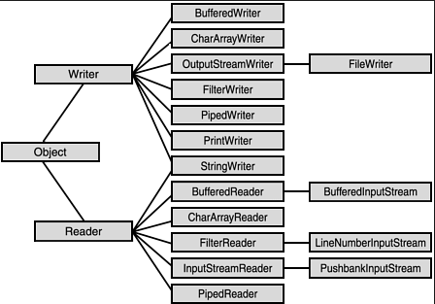
Character Streams Hierarchy
The figure shows the class hierarchies for the Reader and Writer classes.
Reader and Writer are the abstract superclasses for character streams in java.io
These classes are responsible for properly converting each character from its encoding scheme of the native OS to Unicode; they are sensitive to different character-encoding schemes and support international applications.

Slide 5
Byte Streams
Byte streams create binary files.
A binary file essentially contains the memory image of the data. That is, it stores bits as they are in memory.
Binary files are faster to read and write because no translation need take place.
Binary files, however, cannot be read with a text editor.

Slide 6
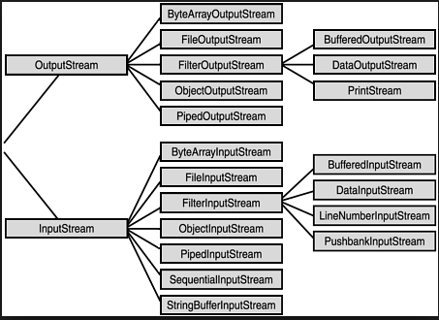
Byte Streams Hierarchy
InputStream and OutputStream provide the API and partial implementation for input streams (streams that read 8-bit bytes) and output streams (streams that write 8-bit bytes). These streams are typically used to read and write binary data such as images and sounds.
Two of the byte stream classes, ObjectInputStream and ObjectOutputStream, are used for object serialization (covered separately).

Slide 7
Classes
Java has 6 classes to support stream I/O
File: An object of this class is either a file or a directory.
OutputStream: base class for byte output streams
InputStream: base class for byte input streams

Slide 8
Classes
Writer: base class for character output streams.
Reader: base class for character input streams.
RandomAccessFile: provides support for random access to a file.
Note that the classes InputStream, OutputStream, Reader, and Writer are abstract classes.

Slide 9
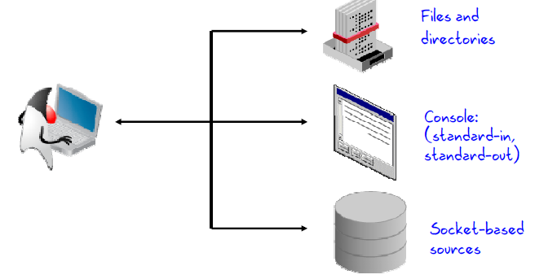
I/O Application
Typically, there are three ways a developer may use input and output:

Slide 10
Binary Files
Binary files store data in the same format used by computer memory to store the values of variables
  No conversion needs to be performed when a value is stored or retrieved from a binary file
Java binary files, unlike other binary language files, are portable
  A binary file created by a Java program can be moved from one computer to another
  These files can then be read by a Java program, but only by a Java program

Slide 11
Writing Simple Data to a Binary File
The class ObjectOutputStream is a stream class that can be used to write to a binary file
  An object of this class has methods to write strings, values of primitive types, and objects to a binary file
A program using ObjectOutputStream needs to import several classes from package java.io:
  import java.io.ObjectOutputStream;
  import java.io.FileOutStream;
  import java.io.IOException;

Slide 12
Opening a Binary File for Output
An ObjectOutputStream object is created and connected to a binary file as follows:
ObjectOutputStream outputStreamName = new
ObjectOutputStream(new
FileOutputStream(FileName));
  The constructor for FileOutputStream may throw a FileNotFoundException
  The constructor for ObjectOutputStream may throw an IOException
  Each of these must be handled

Slide 13
Opening a Binary File for Output
After opening the file, ObjectOutputStream methods can be used to write to the file
  Methods used to output primitive values include writeInt, writeDouble, writeChar, and writeBoolean
UTF is an encoding scheme used to encode Unicode characters that favors the ASCII character set
  The method writeUTF can be used to output values of type String
The stream should always be closed after writing

Slide 14
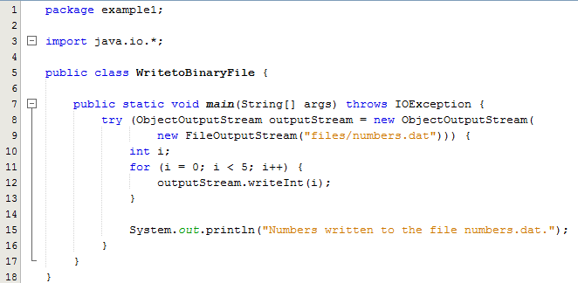
Opening a Binary File for Output - Example
After opening the file on lines 8 and 9 one of the ObjectOutputStream methods
writeInt() is used to write integer values to the file

Slide 15
Reading Simple Data from a Binary File
The class ObjectInputStream is a stream class that can be used to read from a binary file
  An object of this class has methods to read strings, values of primitive types, and objects from a binary file
A program using ObjectInputStream needs to import several classes from package java.io:
  import java.io.ObjectInputStream;
  import java.io.FileInputStream;
  import java.io.IOException;

Slide 16
Opening a Binary File for Reading
An ObjectInputStream object is created and connected to a binary file as follows:
ObjectInputStream inStreamName = new
ObjectInputStream(new
FileInputStream(FileName));
  The constructor for FileInputStream may throw a FileNotFoundException
  The constructor for ObjectInputStream may throw an IOException
  Each of these must be handled

Slide 17
Opening a Binary File for Reading
After opening the file, ObjectInputStream methods can be used to read to the file
  Methods used to input primitive values include readInt, readDouble, readChar, and readBoolean
  The method readUTF is used to input values of type String
If the file contains multiple types, each item type must be read in exactly the same order it was written to the file
The stream should be closed after reading

Slide 18
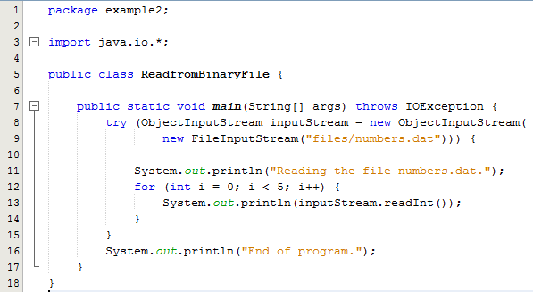
Opening a Binary File for Reading - Example
After opening the file on lines 8 and 9 one of the ObjectOutputStream methods
readInt() is used to read integer values from the file

Slide 19
Checking for the End of a Binary File the Correct Way
All of the ObjectInputStream methods that read from a binary file throw an EOFException when trying to read beyond the end of a file
  This can be used to end a loop that reads all the data in a file
Note that different file-reading methods check for the end of a file in different ways
  Testing for the end of a file in the wrong way can cause a program to go into an infinite loop or terminate abnormally

Slide 20
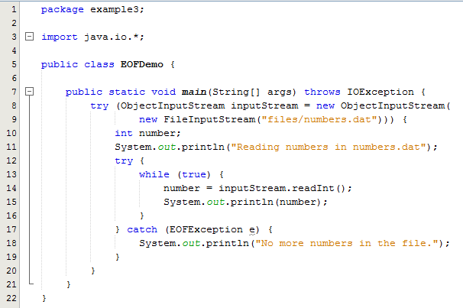
Checking for the End of a Binary File the Correct Way - Example
All of the ObjectInputStream methods that read from a binary file throw an EOFException when trying to read beyond the end of a file
This can be used to end a loop that reads all the data in a file

